Slide 1

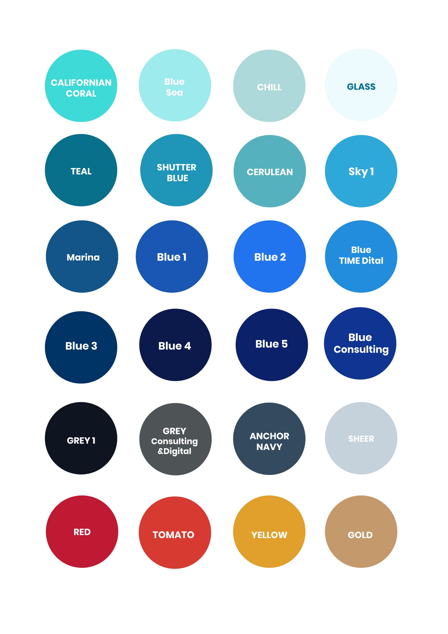


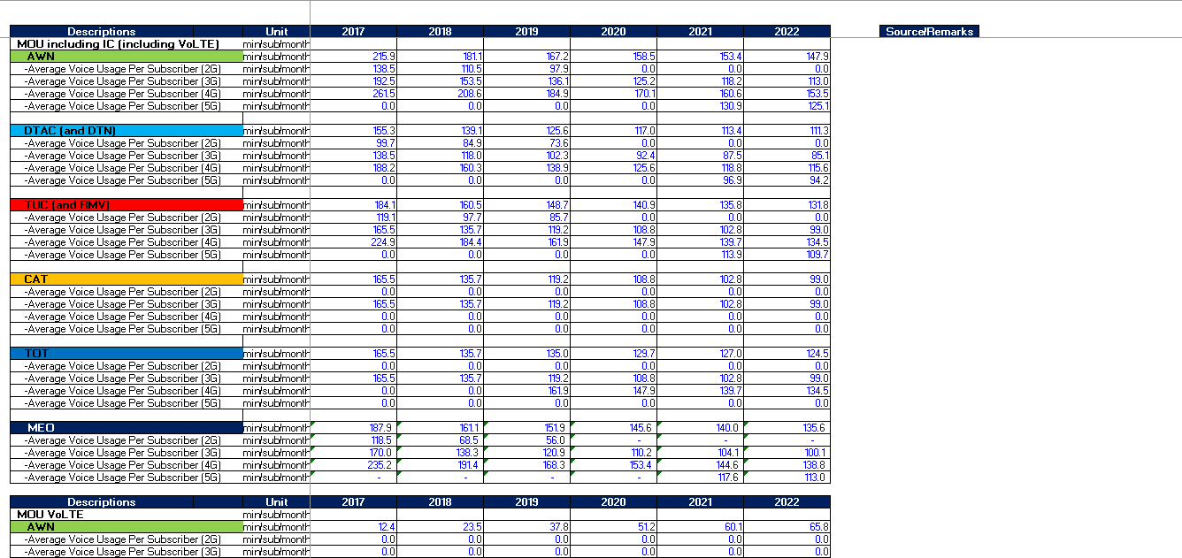
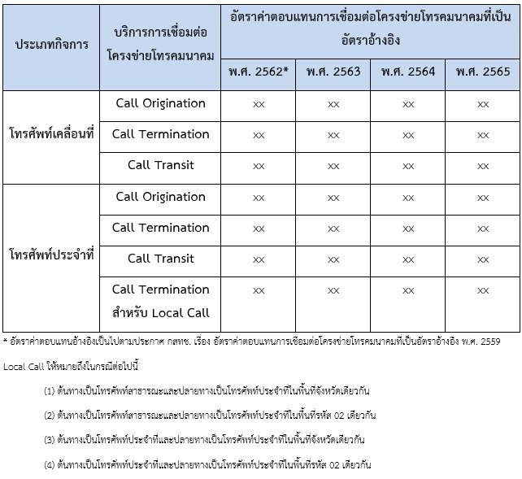
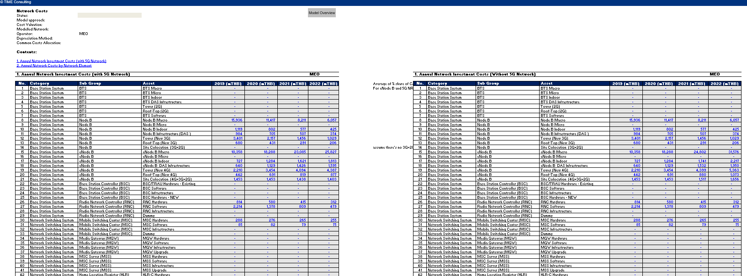
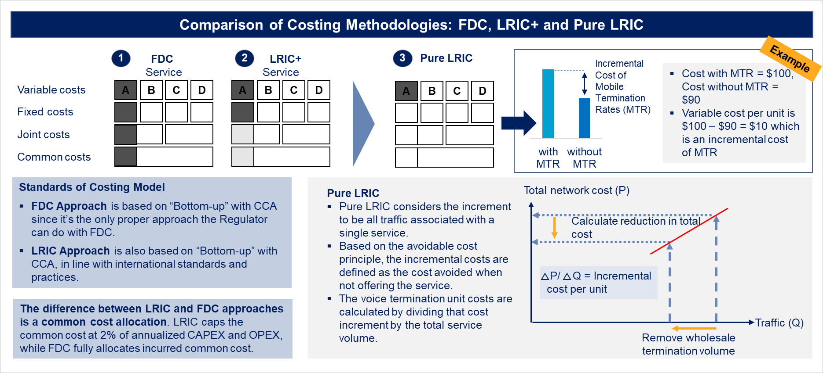
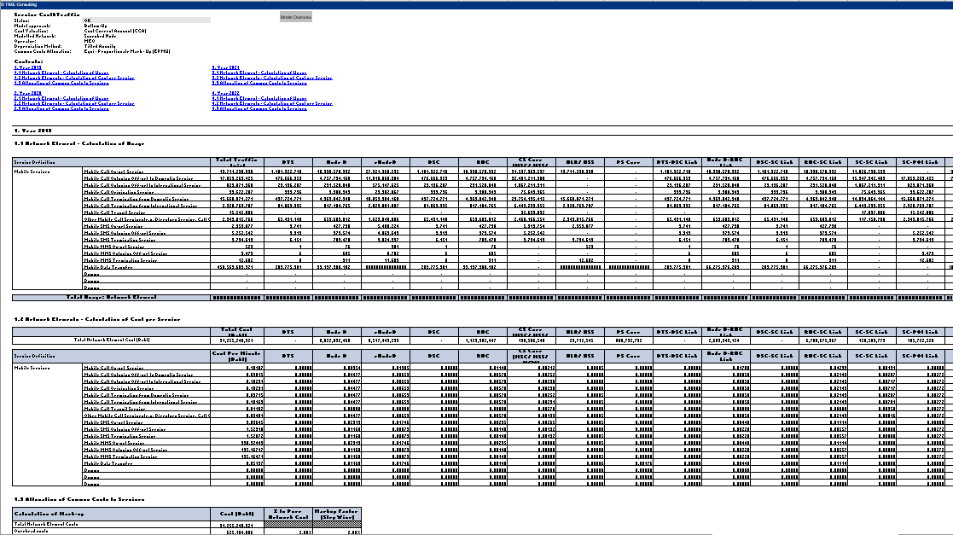



Project Objective
Track | Service Market | Service
Wholesale Interconnection | 1. Fixed Network IC | Fixed Origination
 |  | Fixed Termination
 |  | Fixed Transit
 | 2. Mobile Network IC | Mobile Origination
 |  | Mobile Termination
 |  | Mobile Transit
 | 3. Messaging IC | SMS Termination
 |  | MMS Termination
 | 4. Voice International Incoming | Voice International Incoming
Wholesale Access | 5. MVNO | Wholesale MVNO
 | 6. Domestic Roaming | Domestic Roaming
 | 7. Wholesale Fixed Wireless Broadband Access | Wholesale Fixed Wireless Broadband Access
 | 8. Wholesale Bulk SMS | Wholesale Bulk SMS
 | 9. Wholesale Trunked Radio | Wholesale Trunked Radio
 | 10. International and Internet Connectivity | Internet Connectivity (NIX, IIG/IP Transit and IP Peering)
 |  | IPLC
Track | Service Market | Service
Wholesale Access | 11. Satellite Network | Satellite Connectivity and Transponder Leasing
 |  | Uplink and Other Satellite Services
 | 12. Wholesale Fixed Wireline Broadband Access | LLU on FTTH
 |  | LLU on xDSL
 |  | BSA on FTTH
 |  | BSA on xDSL
 | 13. Domestic Leased Line | Terrestrial – PLC
 |  | Terrestrial - MPLS
 | 14. Mobile Site Infrastructure Sharing | Telecom Tower Rental
 |  | Site Co-location
 |  | Active Antenna System
 | 15. Passive Infrastructure | Fiber Access
 |  | Duct Access
 |  | Pole Access
 | 16. Infrastructure Fund Network | Telecom Tower Rental
 |  | Active Antenna System
 |  | Fiber Access
 | 17. State-aided Network | Fiber Access
= Wholesale Access Services complied with TOR
= Wholesale Interconnection Services complied with TOR
Recommend Appropriate IC Reference Rates
Design Pure LRIC IC calculation standard and guideline.
Regulatory impact assessment of Pure LRIC calculation standard.
Determine MVNO and Domestic Roaming calculation standard.
Case Study: Telecommunication Wholesale Access and Interconnection Service Regulation
Wholesale Interconnection Service (9 Services)
Fixed Call Origination
Fixed Call Termination
Fixed Call Transit
Mobile Call Origination
Mobile Call Termination
Mobile Call Transit
SMS Termination
MMS Termination
Mobile Data Transfer
Thai Market Analysis
Develop Service Costing Model and Reference Rates for B.E. 2563 – 2565 for Fixed and Mobile IC Service
Technical Model
Calculation Framework
Service Provision and Market Competition
Service Charges
Service Regulation
Challenges
Trends
Market Model
IC Reference Rates
To study the technical model, components of material system, and the pattern of duct access in various cases
Subduct and Microducts
Duct access in government agencies areas
Duct access in industrial estates
Network facilities in specific areas
To define rate regulatory framework for duct access and related network facilities
Technical Model
Service Costing Model
Project Objectives
Wholesale Access Service (14 Services)
Voice Intl. Incoming
Wholesale MVNO
Domestic Roaming
Wholesale Fixed Wireless Broadband Access
Wholesale Bulk SMS
Wholesale Trunked Radio
International and Internet Connectivity
Satellite Network
Wholesale Fixed Wireline Broadband Access
Domestic Leased Line
Mobile Site Infra-sharing
Passive Infrastructure
Infrastructure Fund
State-aided Network
Determine the Calculation Standard and Costing Models for Access Services
Access’ Reference Rates and Recommendation on Service Regulation
International Benchmark
Duct Rate Regulation
Service Regulation
Service Charge’s Calculation Methodology
Service Charges
To develop duct rate regulation for duct access and related network facilities
Standard calculation
Rates and charges

